Slide 1
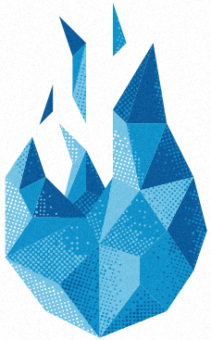


Special features of cantera-avbp

Slide 2
Several features are coded in cantera-avbp
AVBP transport model
The use of custom kinetics
Thickening a flame
Alternative remeshing possible
Partial Equilibrium Assumption for 2S chemistry
Flamelet computation
Soot equations
Notes:
----- Notes de la réunion (12/11/2014 12:11) -----
CA can perform 0D simulation so equ cal & time evol of closed and open reactors
It can also perform STEADY 1D simulations, mostly premixed configurations but a counterflow diffusion flame model is also implemented
recently it also became possible to add surface ..

Slide 3
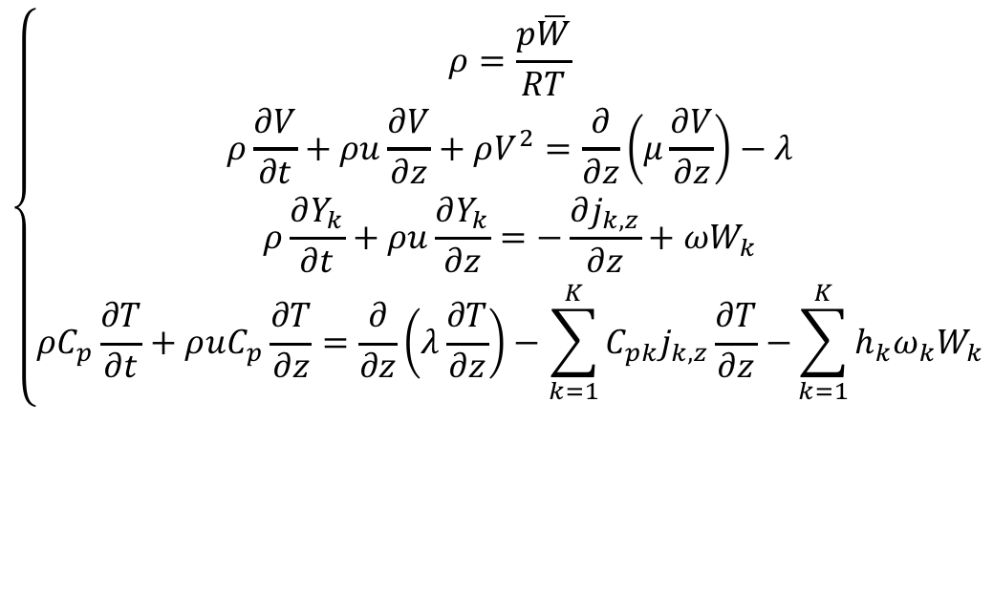
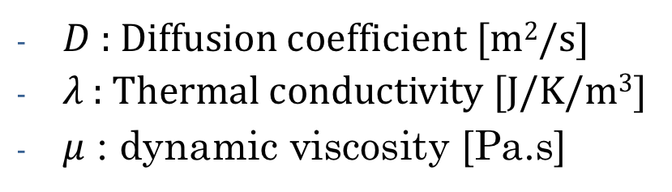
1.Transport
What are we talking about ?
$D$ : Diffusion coefficient [m²/s]
$λ$ : Thermal conductivity [J/K/m³]
$μ$ : dynamic viscosity [Pa.s]
$$\left\{\begin{aligned}ρ=\frac{p\overline{W}}{RT} \\ ρ\frac{∂V}{∂t}+ρu\frac{∂V}{∂z}+ρV^{2}=\frac{∂}{∂z}\left(μ\frac{∂V}{∂z}\right)−λ \\ ρ\frac{∂Y_{k}}{∂t}+ρu\frac{∂Y_{k}}{∂z}=−\frac{∂j_{k,z}}{∂z}+ωW_{k} \\ ρC_{p}\frac{∂T}{∂t}+ρuC_{p}\frac{∂T}{∂z}=\frac{∂}{∂z}\left(λ\frac{∂T}{∂z}\right)−\sum_{k=1}^{K}{C_{pk}j_{k,z}\frac{∂T}{∂z}−}\sum_{k=1}^{K}{h_{k}ω_{k}W_{k}}\end{aligned}\right.$$
Notes:
----- Notes de la réunion (12/11/2014 12:11) -----
CA can perform 0D simulation so equ cal & time evol of closed and open reactors
It can also perform STEADY 1D simulations, mostly premixed configurations but a counterflow diffusion flame model is also implemented
recently it also became possible to add surface ..

Slide 4
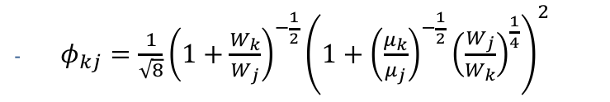
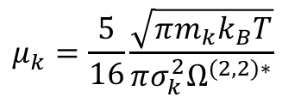
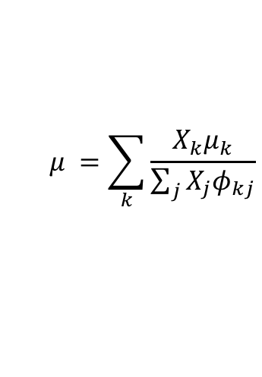
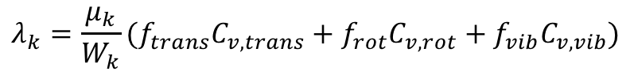
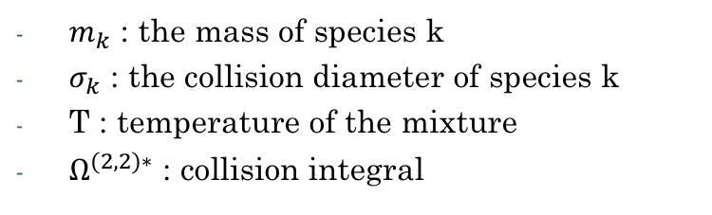
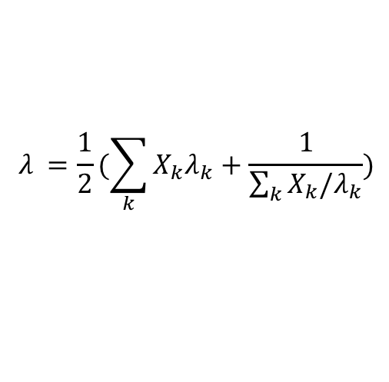
1.Transport
You have anyway in cantera, based on Lennard-Jones potentials :
- For the viscosity :
$m_{k}$ : the mass of species k
$σ_{k}$ : the collision diameter of species k
T : temperature of the mixture
$Ω^{(2,2)∗}$ : collision integral
$$μ_{k}=\frac{5}{16}\frac{\sqrt{πm_{k}k_{B}T}}{πσ_{k}^{2}Ω^{(2,2)∗}}$$
$$μ_{ }=\sum_{k}{\frac{X_{k}μ_{k}}{\sum_{j}{X_{j}φ_{kj}}}}$$
$φ_{kj}=\frac{1}{\sqrt{8}}{\left(1+\frac{W_{k}}{W_{j}}\right)}^{−\frac{1}{2}}{\left(1+{\left(\frac{μ_{k}}{μ_{j}}\right)}^{−\frac{1}{2}}{\left(\frac{W_{j}}{W_{k}}\right)}^{\frac{1}{4}}\right)}^{2}$
- For the heat conductivity :
$$λ_{k}=\frac{μ_{k}}{W_{k}}(f_{trans}C_{v,trans}+f_{rot}C_{v,rot}+f_{vib}C_{v,vib})$$
$$λ_{ }=\frac{1}{2}(\sum_{k}{X_{k}λ_{k}+\frac{1}{\sum_{k}{X_{k}/λ_{k}}}})$$
https://www.cerfacs.fr/avbp7x/HELP/MOULINETTE/XML2AV/xml2av.pdf
Notes:
----- Notes de la réunion (12/11/2014 12:11) -----
CA can perform 0D simulation so equ cal & time evol of closed and open reactors
It can also perform STEADY 1D simulations, mostly premixed configurations but a counterflow diffusion flame model is also implemented
recently it also became possible to add surface ..

Slide 5
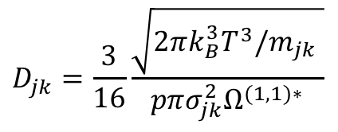
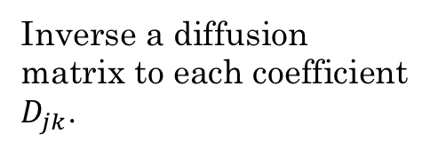
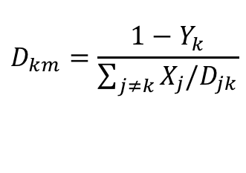
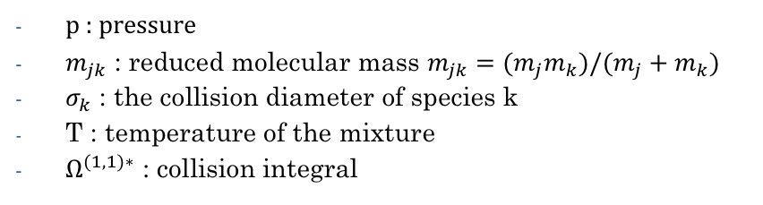
1.Transport
- For the diffusion :
1. Multi
✅ Best in terms of accuracy.
❌ Very very long !!
Inverse a diffusion matrix to each coefficient $D_{jk}$.
gas.transport_model = ‘Multi’
Or
transport = ‘Multi’
in the .cti
2. Mix
p : pressure
$m_{jk}$ : reduced molecular mass $m_{jk}=(m_{j}m_{k})/(m_{j}+m_{k})$
$σ_{k}$ : the collision diameter of species k
T : temperature of the mixture
$Ω^{(1,1)∗}$ : collision integral
$$D_{jk}=\frac{3}{16}\frac{\sqrt{2πk_{B}^{3}T^{3}/m_{jk} }}{pπσ_{jk}^{2}Ω^{(1,1)∗}}$$
✅ Best in terms of accuracy/cost.
❌ Still costly if used in 3D codes.
$$D_{km}=\frac{1−Y_{k}}{\sum_{j≠k}{X_{j}/D_{jk}}}$$
gas.transport_model = ‘Mix’
Notes:
----- Notes de la réunion (12/11/2014 12:11) -----
CA can perform 0D simulation so equ cal & time evol of closed and open reactors
It can also perform STEADY 1D simulations, mostly premixed configurations but a counterflow diffusion flame model is also implemented
recently it also became possible to add surface ..

Slide 6
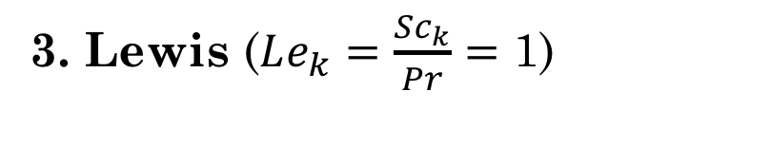
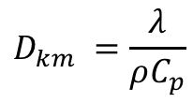
1.Transport
3. Lewis ($Le_{k}=\frac{Sc_{k}}{Pr}=$ 1)
✅ Very low cost.
❌ Big loss in accuracy !
Simplified expression
$${D_{km}}_{ }=\frac{λ}{ρC_{p}}$$
gas.transport_model = ‘UnityLewis’
Notes:
----- Notes de la réunion (12/11/2014 12:11) -----
CA can perform 0D simulation so equ cal & time evol of closed and open reactors
It can also perform STEADY 1D simulations, mostly premixed configurations but a counterflow diffusion flame model is also implemented
recently it also became possible to add surface ..

Slide 7
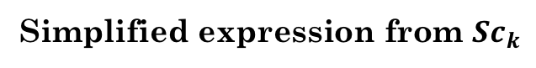
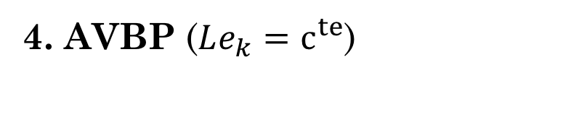
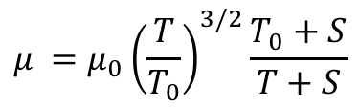
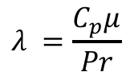
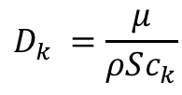
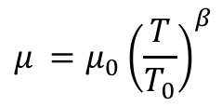
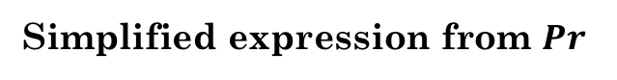
1.Transport
4. AVBP ($Le_{k}=c^{te}$)
✅ Low cost.
❌ Loss in accuracy, you have to check !
Power law
or
Sutherland law
$$μ_{ }=μ_{0}{\left(\frac{T}{T_{0}}\right)}^{β}$$
$$μ_{ }=μ_{0}{\left(\frac{T}{T_{0}}\right)}^{3/2}\frac{T_{0}+S}{T+S}$$
Simplified expression from $Sc_{k}$
Simplified expression from $Pr$
$${D_{k}}_{ }=\frac{μ}{ρSc_{k}}$$
$$λ_{ }=\frac{C_{p}μ}{Pr}$$
gas.transport_model = ‘AVBP’
Notes:
----- Notes de la réunion (12/11/2014 12:11) -----
CA can perform 0D simulation so equ cal & time evol of closed and open reactors
It can also perform STEADY 1D simulations, mostly premixed configurations but a counterflow diffusion flame model is also implemented
recently it also became possible to add surface ..

Slide 8
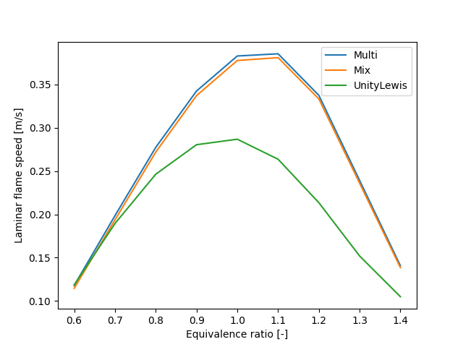
1.Transport
Gri 30 with T=300K, P=1bar.
Notes:
----- Notes de la réunion (12/11/2014 12:11) -----
CA can perform 0D simulation so equ cal & time evol of closed and open reactors
It can also perform STEADY 1D simulations, mostly premixed configurations but a counterflow diffusion flame model is also implemented
recently it also became possible to add surface ..

Slide 9
2. Customkinetics
If you want to give another thing to CANTERA than the information provided in a .cti.
A f90 to be included in the code
Useful if you want to have a special handling of the kinetics (ex: algebraic relations between species)
kinetics = ‘custom’
in the .cti
import cantera as ct
ct.compile_fortran(‘mechanism.f90’)
in the script
Notes:
----- Notes de la réunion (12/11/2014 12:11) -----
CA can perform 0D simulation so equ cal & time evol of closed and open reactors
It can also perform STEADY 1D simulations, mostly premixed configurations but a counterflow diffusion flame model is also implemented
recently it also became possible to add surface ..

Slide 10
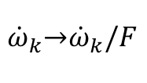
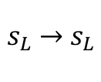
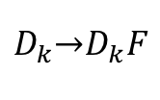
3. Thickening
To be able to test the chemistry for
f.flame.thick = value
$${\dot{ω}}_{k}\underset{→}{ }{\dot{ω}}_{k}/F$$
$$D_{k}\underset{→}{ }D_{k}F$$
$$s_{L} \underset{→}{ }{ s}_{L}$$
https://cerfacs.fr/chemistry-repo/pub/cantera_jypnb/Thickening.html
Notes:
----- Notes de la réunion (12/11/2014 12:11) -----
CA can perform 0D simulation so equ cal & time evol of closed and open reactors
It can also perform STEADY 1D simulations, mostly premixed configurations but a counterflow diffusion flame model is also implemented
recently it also became possible to add surface ..

Slide 11
4. Alternative remeshing
Three options for “refine_grid” parameter:
“disabled” : no refinement. Can be useful if one wants to test a regular-spaced grid.
“refine” : default refinement method of CANTERA. Is very useful to refine more the flamefront than the edges.
“remesh” : CERFACS method, useful to go from one grid to another.
refine_grid = ‘remesh’
f.solve(loglevel, refine_grid)
Notes:
----- Notes de la réunion (12/11/2014 12:11) -----
CA can perform 0D simulation so equ cal & time evol of closed and open reactors
It can also perform STEADY 1D simulations, mostly premixed configurations but a counterflow diffusion flame model is also implemented
recently it also became possible to add surface ..

Slide 12
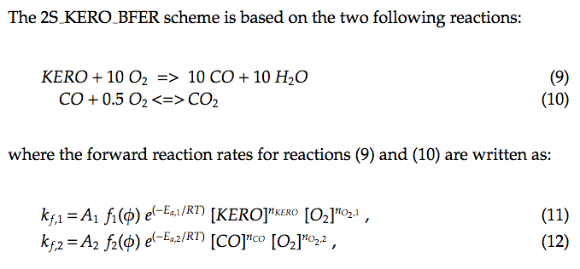
5. Partial Equilibrium Assumption (PEA)
Special to BFER -> correction for the rich part.
Only available with AVBP format.
https://cerfacs.fr/chemistry-repo/pub/cantera_jypnb/Pea.html
Notes:
----- Notes de la réunion (12/11/2014 12:11) -----
CA can perform 0D simulation so equ cal & time evol of closed and open reactors
It can also perform STEADY 1D simulations, mostly premixed configurations but a counterflow diffusion flame model is also implemented
recently it also became possible to add surface ..

Slide 13
6. Flamelet computation
Mixture fraction variable : z
Trick : change of space from
x (position) to z (mixture fraction)
✅ Faster computations (20s instead of 200s).
✅ Better stability (CDF is very capricious.
❌ No return possible to x-space.
f = ct.Flamelet()
https://cerfacs.fr/chemistry-repo/pub/cantera_jypnb/CDF-Flamelet.html
Notes:
----- Notes de la réunion (12/11/2014 12:11) -----
CA can perform 0D simulation so equ cal & time evol of closed and open reactors
It can also perform STEADY 1D simulations, mostly premixed configurations but a counterflow diffusion flame model is also implemented
recently it also became possible to add surface ..

Slide 14
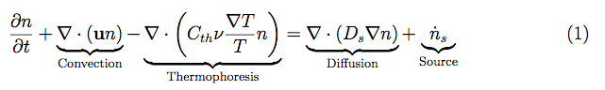
7. Soot equation
Enables the computation of soot after a flame in cantera
https://cerfacs.fr/chemistry-repo/priv/cantera_soot/Handbook_cantera-soot.pdf
Notes:
----- Notes de la réunion (12/11/2014 12:11) -----
CA can perform 0D simulation so equ cal & time evol of closed and open reactors
It can also perform STEADY 1D simulations, mostly premixed configurations but a counterflow diffusion flame model is also implemented
recently it also became possible to add surface ..

Slide 15
Bonus: Cantera as an input of AVBP
It is possible to generate a 1D flame from Cantera and make an initialization for AVBP
It is possible to generate a gas_out with the help of Cantera.
It is possible to use Cantera to calculate evaporation with evol_evap0D.
It is possible to create the mixture_database.dat with the xml2av tool.
f.write_AVBP(‘name_of_file.csv’)
Notes:
----- Notes de la réunion (12/11/2014 12:11) -----
CA can perform 0D simulation so equ cal & time evol of closed and open reactors
It can also perform STEADY 1D simulations, mostly premixed configurations but a counterflow diffusion flame model is also implemented
recently it also became possible to add surface ..

Slide 16
Bonus 2: Cantera as an input of AVBP
You have a separate git called cantera-tools
Initialize 3D AVBP calculations with cantera
Optimize Schmidt & Prandtl numbers
https://chemistry.cerfacs.fr/en/avbp/avbp-tools-for-chemistry/
Notes:
----- Notes de la réunion (12/11/2014 12:11) -----
CA can perform 0D simulation so equ cal & time evol of closed and open reactors
It can also perform STEADY 1D simulations, mostly premixed configurations but a counterflow diffusion flame model is also implemented
recently it also became possible to add surface ..

Slide 17
BACKUP
http://www.cmap.polytechnique.fr/~giovangi/convergent.pdf
https://chemistry.cerfacs.fr/en/cantera/cantera-tutorials/
Notes:
----- Notes de la réunion (12/11/2014 12:11) -----
CA can perform 0D simulation so equ cal & time evol of closed and open reactors
It can also perform STEADY 1D simulations, mostly premixed configurations but a counterflow diffusion flame model is also implemented
recently it also became possible to add surface ..

